Slide 1
Recurrent neural networks (RNN)

Slide 2
Recurrent neural networks (RNN)
Recurrent Neural Network(RNN) are a type of Neural Network where the output from previous step are fed as input to the current step.
(RNN) are part of a larger group of algorithms called sequence models.
Sequence models made giant leaps forward in the fields of speech recognition, music generation, DNA sequence analysis, machine translation, and many more.
The main and most important feature of RNN is Hidden state, which remembers some information about a sequence.

Slide 3
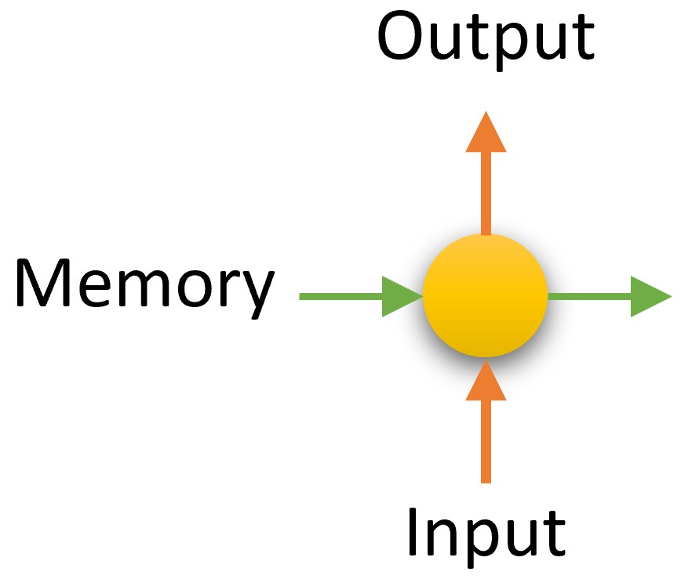
RNN
RNN have a “memory” which remembers all information about what has been calculated.
It uses the same parameters for each input as it performs the same task on all the inputs or hidden layers to produce the output.

Slide 4
Logic
The logic behind a RNN is to consider the sequence of the input.
For us to predict the next word in the sentence we need to remember what word appeared in the previous time step.
For us to predict the next word in the sentence we need to remember what word appeared in the previous time step.
As these neural network consider the previous word during predicting, it acts like a memory storage unit which stores it for a short period of time.

Slide 5
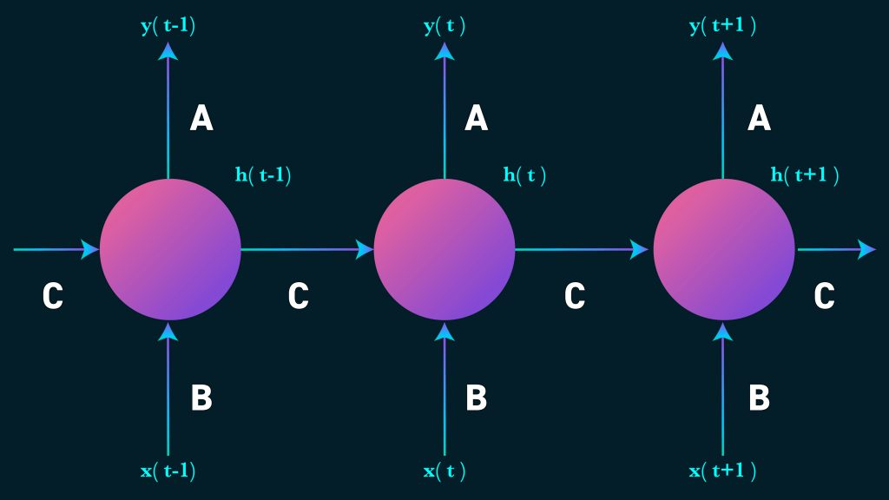
RNN

Slide 6
RNN
The above diagram represents a three layer recurrent neural network which is unrolled to understand the inner iterations.
xt is the input at time step t. xt-1 will be the previous word in the sentence or the sequence.
ht will be the hidden state at time step t.
The output of this state will be non-linear and considered with the help of an activation function like tanh or ReLU.
ht-1 is evaluated from the previous hidden layer.

Slide 7
RNN
yt will be our output at the time step t. It is the a word which has the highest probability considered using a an activation function like yt = maxout(Ast).
The RNN in the above figure has same evaluation at teach step considering the weight A, B and C.
But the inputs differ at each time step making the process fast and less complex.
It remembers only the previous and not the words before it acting like a memory.

Slide 8
Language Modelling
In this method, the likelihood of a word in a sentence is considered.
The probability of the output of a particular time-step is used to sample the words in the next iteration(memory).
In Language Modelling, input is usually a sequence of words from the data and output will be a sequence of predicted word by the model.
the output of the previous time step will be the input of the present time step.

Slide 9
Speech Recognition:
A set of inputs containing phoneme(acoustic signals) from an audio is used as an input.
This network will compute the phonemes and produce a phonetic segments with the likelihood of output.

Slide 10
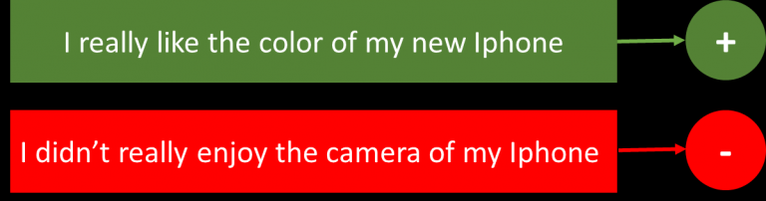
Sentiment Classification
This can be a task of simply classifying tweets into positive and negative sentiment.
So here the input would be a tweet of varying lengths, while output is of a fixed type and size.

Slide 11
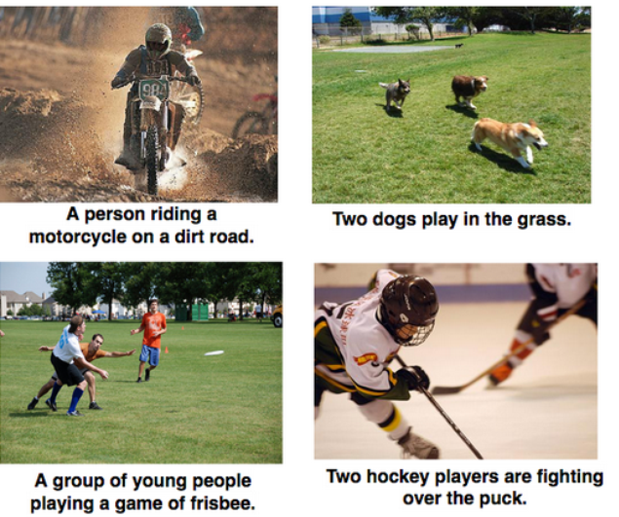
Image Captioning
It describes about the image by analyzing its features.
We have a single input – the image, and a series or sequence of words as output.
Here the image might be of a fixed size, but the output is a description of varying lengths.

Slide 12

Language Translation
This basically means that we have some text in a particular language let’s say English, and we wish to translate it in Chinese.
Each language has it’s own semantics and would have varying lengths for the same sentence.

